Slide 1
Resource Reservation IBM Hackathon
By
Suresh Yarra
Prudhvi Raj Atluri
Shravan Boda
Anil Kanth Nelluri

Slide 2
Idea
To automate resource booking procedure in recreation center, we came up with an idea to develop mobile application in Android using IBM Bluemix mobile cloud.

Slide 3
Features
Resource Booking:
This is a feature that allows students to know if resources in recreation center are available.
It helps save time, because it is one stop to go using smart phone.

Slide 4
Implementation
We used IBM data objects to communicate with mobile cloud.
We used SSO pathway login services for login into application.
Used native android for front end user interface

Slide 5
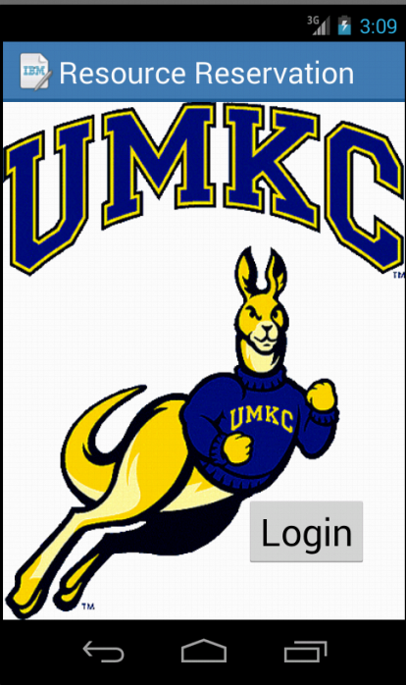
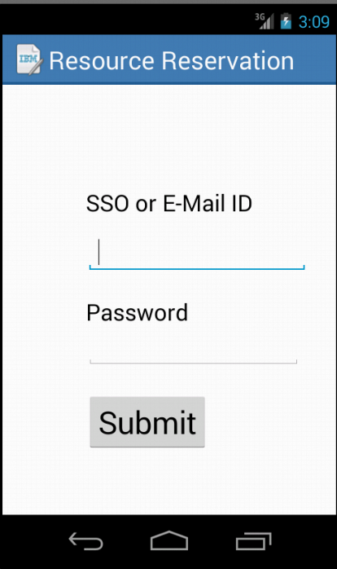
Screen Shots

Slide 6
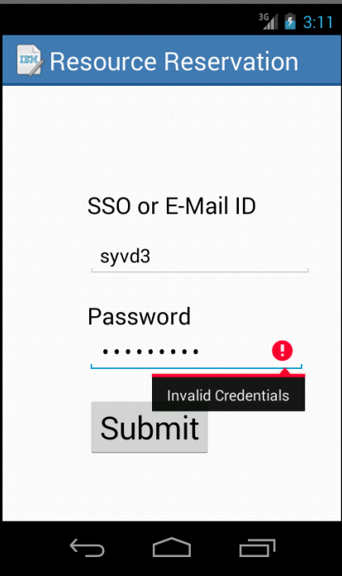
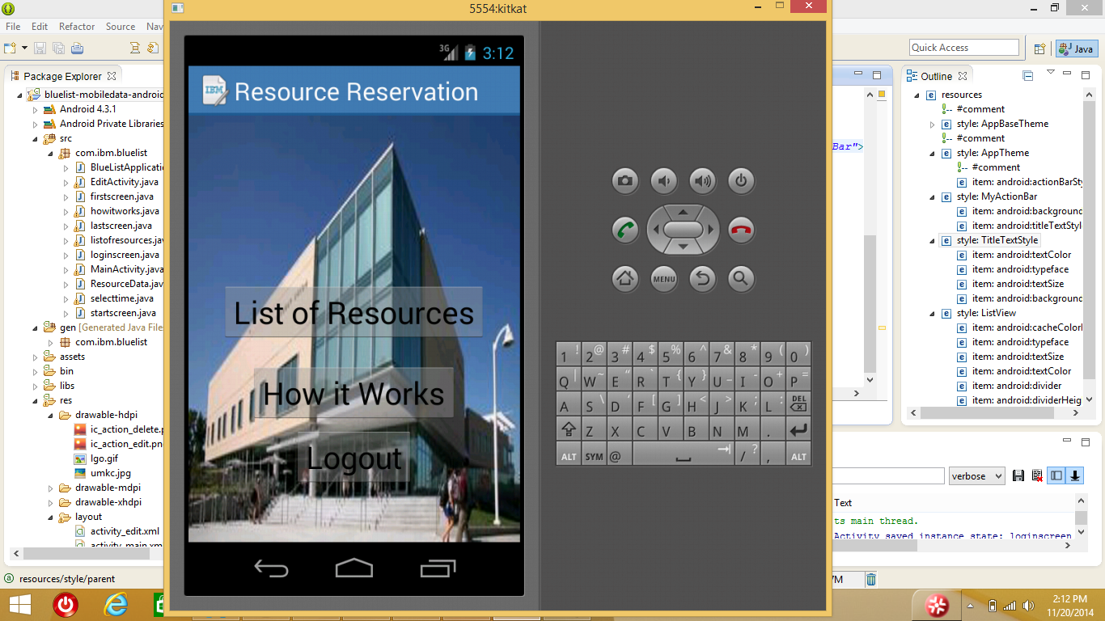
Screen Shots

Slide 7
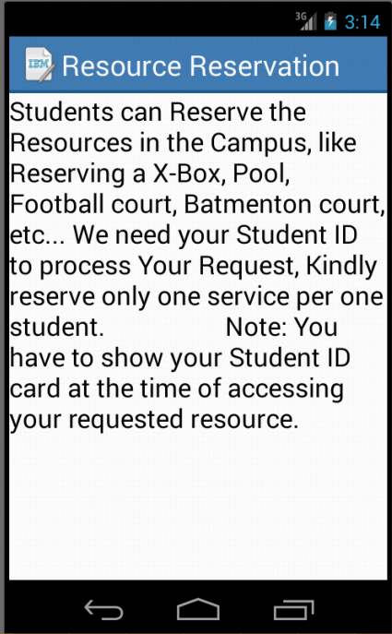
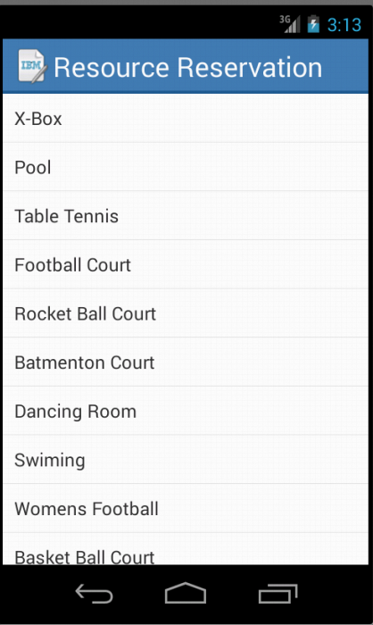
Screen Shots

Slide 8
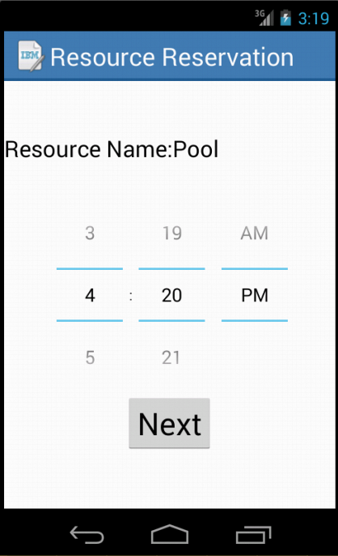
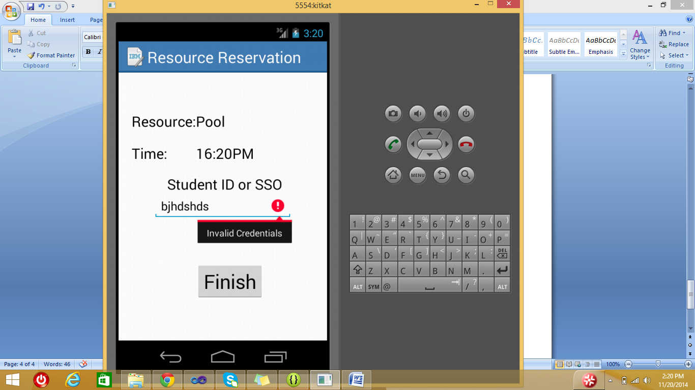
Screen Shots

Slide 9
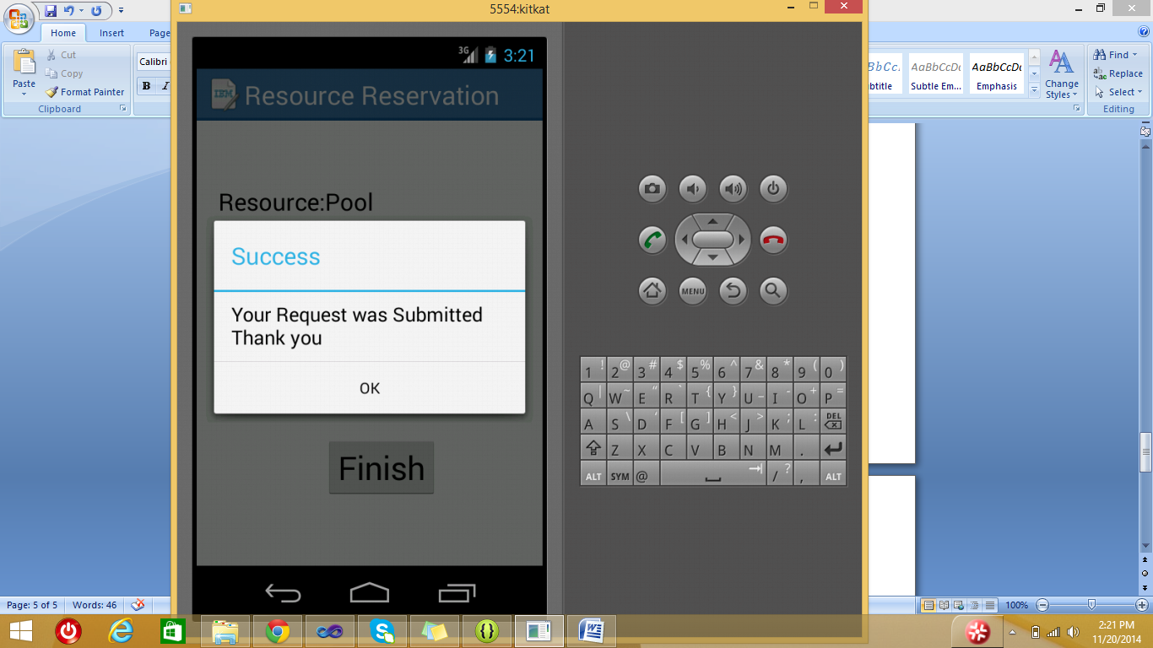
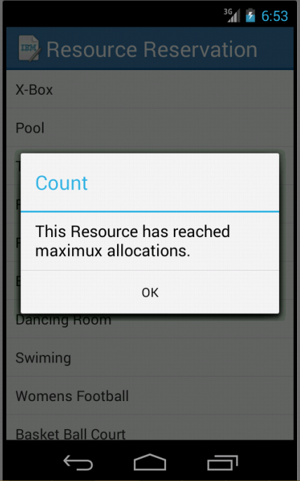
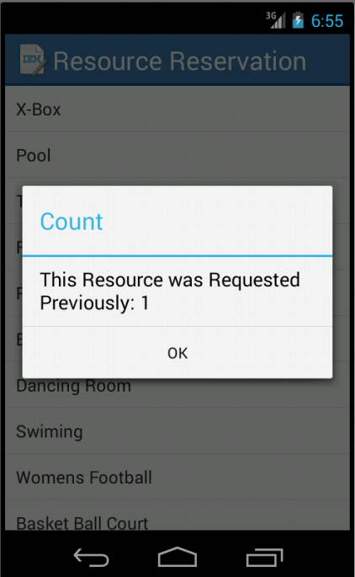
Screen Shots

Slide 10
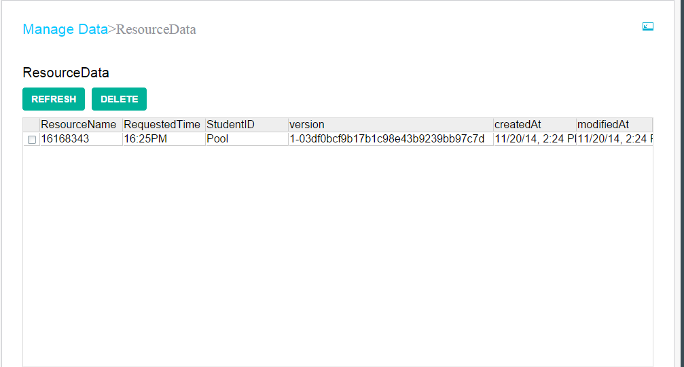

Slide 11
DEMO

Slide 12
Thank You

